Slide 1
KOTLIN + ANKO Simplificando o que já é simples

Slide 2
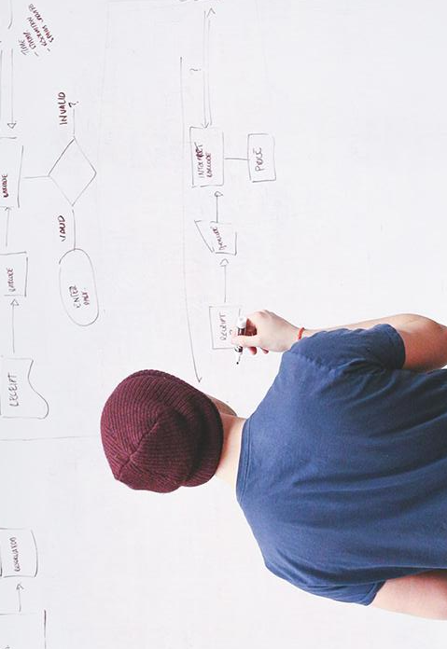
HELLO!
Meu nome é Julio Borges
Analista Desenvolvedor na Inovação Computação Móvel desde 2009
Mobile, Desktop, Web e o que mais aparecer por aí

Slide 3
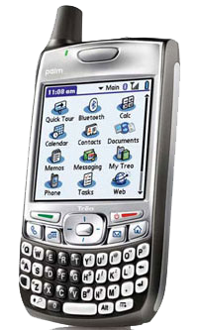
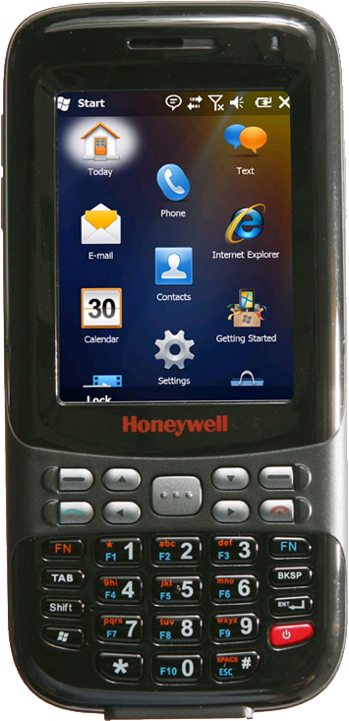


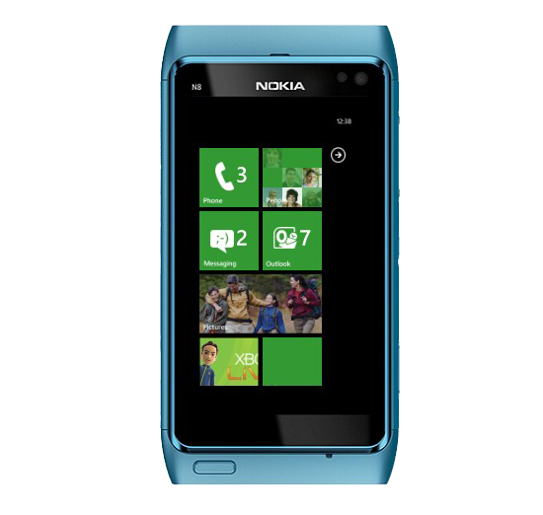
My Story

Slide 4
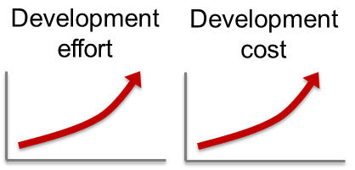

Slide 5




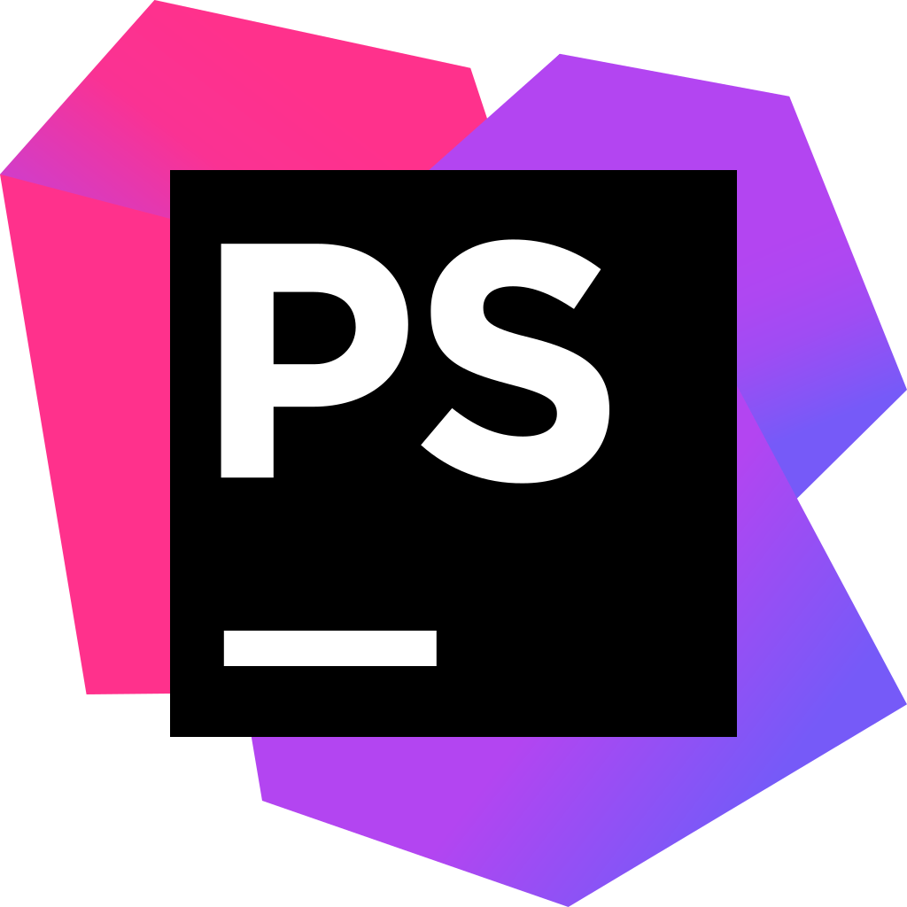
Notes:
Em meados de 2014, eu ouvi falar que o pessoal da Jetbrains desde 2011 estava desenvolvendo uma nova linguagem, que para eles iria ter tudo que eles procuravam e não encontravam em nenhuma outra linguagem (com exceção da linguagem Scala que segundo eles era muito lenta para compilar). Como sempre não dei crédito.

Slide 6
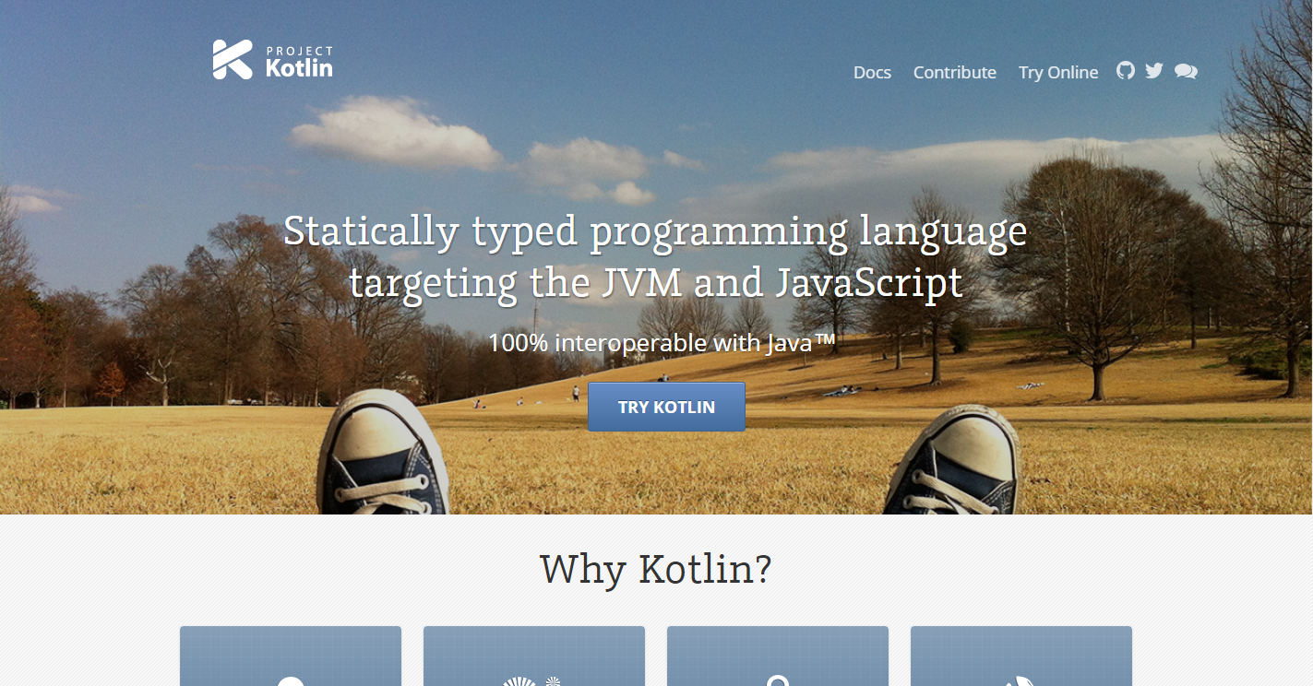

Slide 7

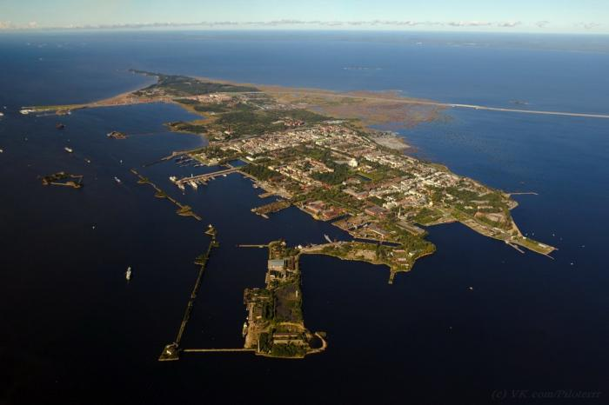
Kotlin !?
Criada pela Jetbrains em 2011
Primeira versão estável em 2016
Roda em cima da JVM
100% Inter operável com Java
Mais produtivo
POO e programação Funcional
Null safety, data classes, lambdas e muito mais...

Slide 8
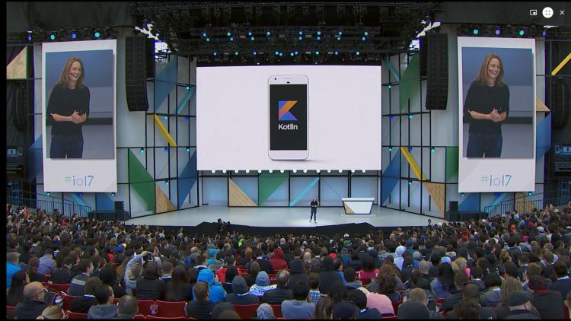


Slide 9
Vem ni mim kotlin !

Slide 10
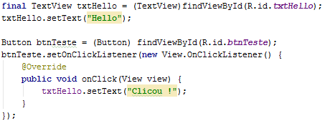
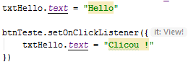
Java
Kotlin

Slide 12
“Não existe nada tão bom que não possa melhorar”

Slide 13
You can also split your content
White
Is the color of milk and fresh snow, the color produced by the combination of all the colors of the visible spectrum.
Black
Is the color of coal, ebony, and of outer space. It is the darkest color, the result of the absence of or complete absorption of light.

Slide 14
In two or three columns
Yellow
Is the color of gold, butter and ripe lemons. In the spectrum of visible light, yellow is found between green and orange.
Blue
Is the colour of the clear sky and the deep sea. It is located between violet and green on the optical spectrum.
Red
Is the color of blood, and because of this it has historically been associated with sacrifice, danger and courage.

Slide 15
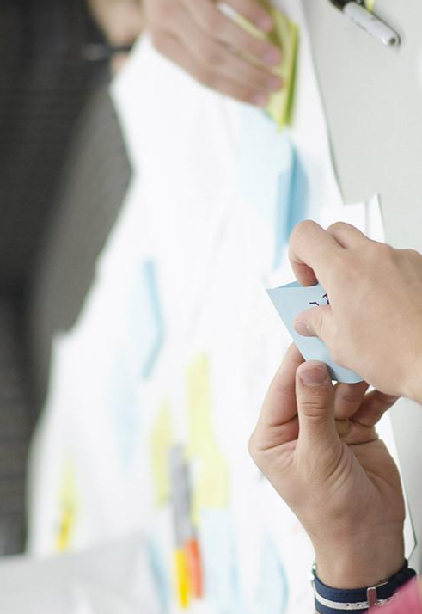
A picture is worth a thousand words
A complex idea can be conveyed with just a single still image, namely making it possible to absorb large amounts of data quickly.

Slide 16
Use charts to explain your ideas
White
Gray
Black

Slide 17
And tables to compare data
 | A | B | C
Yellow | 10 | 20 | 7
Blue | 30 | 15 | 10
Orange | 5 | 24 | 16

Slide 18
Maps
our office

Slide 19
89,526,124
Whoa! That’s a big number, aren’t you proud?

Slide 20
89,526,124$
185,244 users
100%
That’s a lot of money
And a lot of users
Total success!

Slide 21
Our process is easy
FIRST
SECOND
LAST

Slide 22
Let’s review some concepts
Yellow
Is the color of gold, butter and ripe lemons. In the spectrum of visible light, yellow is found between green and orange.
Blue
Is the colour of the clear sky and the deep sea. It is located between violet and green on the optical spectrum.
Red
Is the color of blood, and because of this it has historically been associated with sacrifice, danger and courage.
Yellow
Is the color of gold, butter and ripe lemons. In the spectrum of visible light, yellow is found between green and orange.
Blue
Is the colour of the clear sky and the deep sea. It is located between violet and green on the optical spectrum.
Red
Is the color of blood, and because of this it has historically been associated with sacrifice, danger and courage.

Slide 23
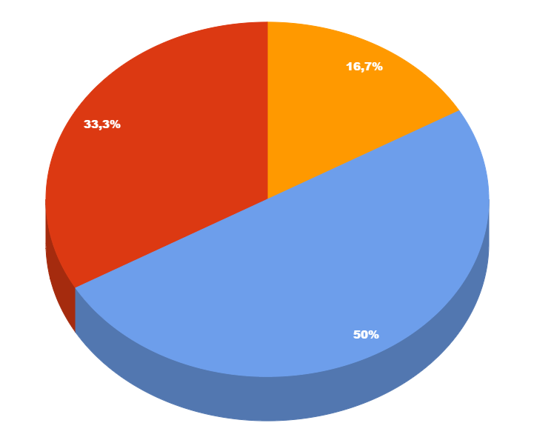
You can copy&paste graphs from Google Sheets

Slide 24
ANDROID PROJECT
Show and explain your web, app or software projects using these gadget templates.
Place your screenshot here

Slide 25
iPHONE PROJECT
Show and explain your web, app or software projects using these gadget templates.
Place your screenshot here

Slide 26
TABLET PROJECT
Show and explain your web, app or software projects using these gadget templates.
Place your screenshot here

Slide 27
DESKTOP PROJECT
Show and explain your web, app or software projects using these gadget templates.
Place your screenshot here

Slide 28
THANKS!
Any questions?
You can find me at:
@username · user@mail.me

Slide 29
Credits
Special thanks to all the people who made and released these awesome resources for free:
Presentation template by SlidesCarnival
Photographs by Startupstockphotos

Slide 30

Presentation design
This presentation uses the following typographies:
Titles: Hind
Body copy: Hind
You can download the fonts on this page:
https://www.google.com/fonts#UsePlace:use/Collection:Hind:400,700
Click on the “arrow button” that appears on the top right
You don’t need to keep this slide in your presentation. It’s only here to serve you as a design guide if you need to create new slides or download the fonts to edit the presentation in PowerPoint®

Slide 31
SlidesCarnival icons are editable shapes.
This means that you can:
Resize them without losing quality.
Change fill color and opacity.
Change line color, width and style.
Isn’t that nice? :)
Examples:

Slide 32
😉
Now you can use any emoji as an icon!
And of course it resizes without losing quality and you can change the color.
How? Follow Google instructions https://twitter.com/googledocs/status/730087240156643328
✋👆👉👍👤👦👧👨👩👪💃🏃💑❤😂😉😋😒😭👶😸🐟🍒🍔💣📌📖🔨🎃🎈🎨🏈🏰🌏🔌🔑 and many more...

